Slide 1
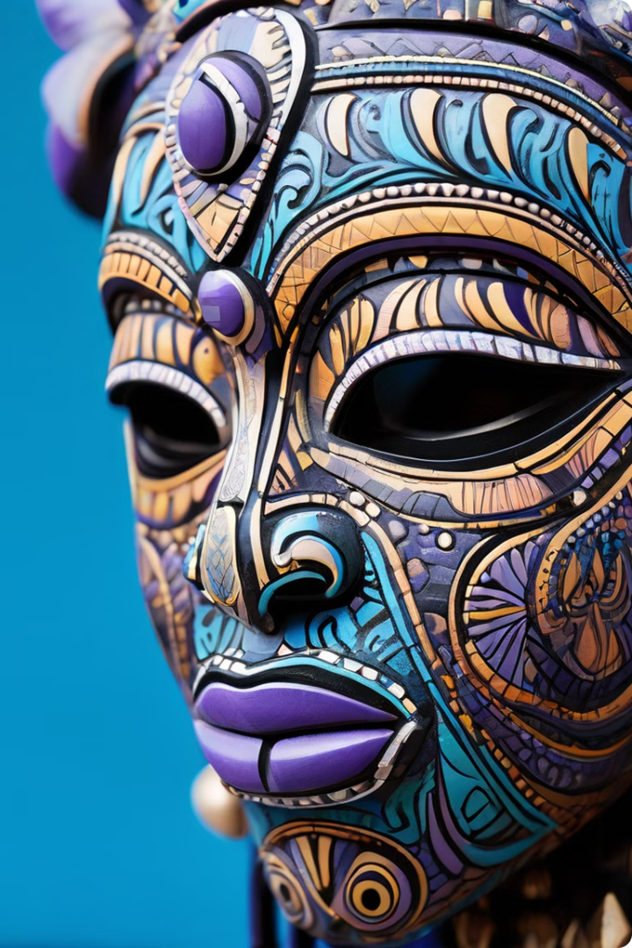

African Masks: Symbolism, Rituals, and Artistry
African masks are powerful cultural artifacts that transcend mere adornment. They are conduits for ancestral spirits, embodiments of deities, and expressions of deeply held beliefs, woven into the fabric of diverse African societies.
Shawn Ngala

Slide 2
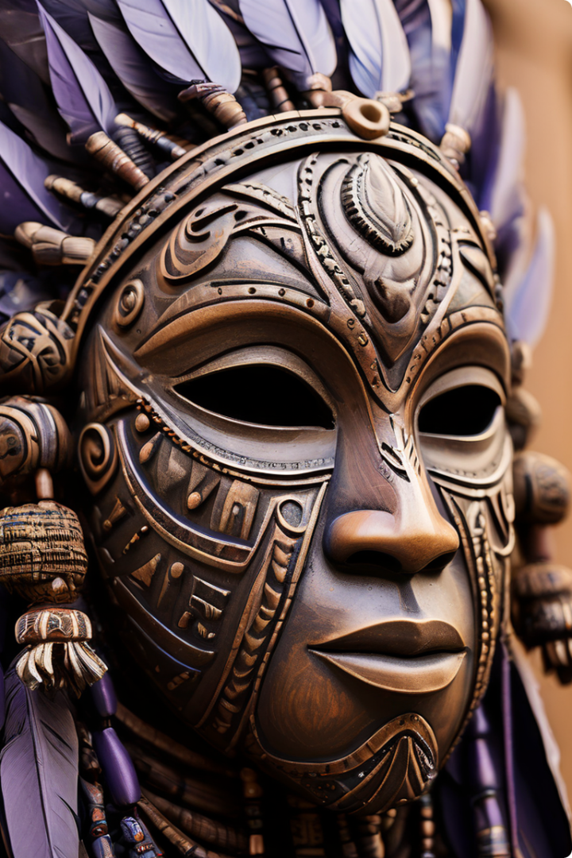
Symbolism and Meaning
1
Spiritual Connection
Masks often embody the spirits of ancestors, deities, or mythical creatures, serving as intermediaries between the human and spiritual realms.
2
Community Identity
They reflect the values, beliefs, and traditions of specific ethnic groups, strengthening social cohesion and shared heritage.
3
Symbolic Representations
Motifs and designs convey specific meanings related to fertility, protection, healing, power, and other concepts vital to the community's well-being.
4
Gender and Age
Certain masks are associated with specific genders or age groups, signifying roles, responsibilities, and social status within the community.

Slide 3
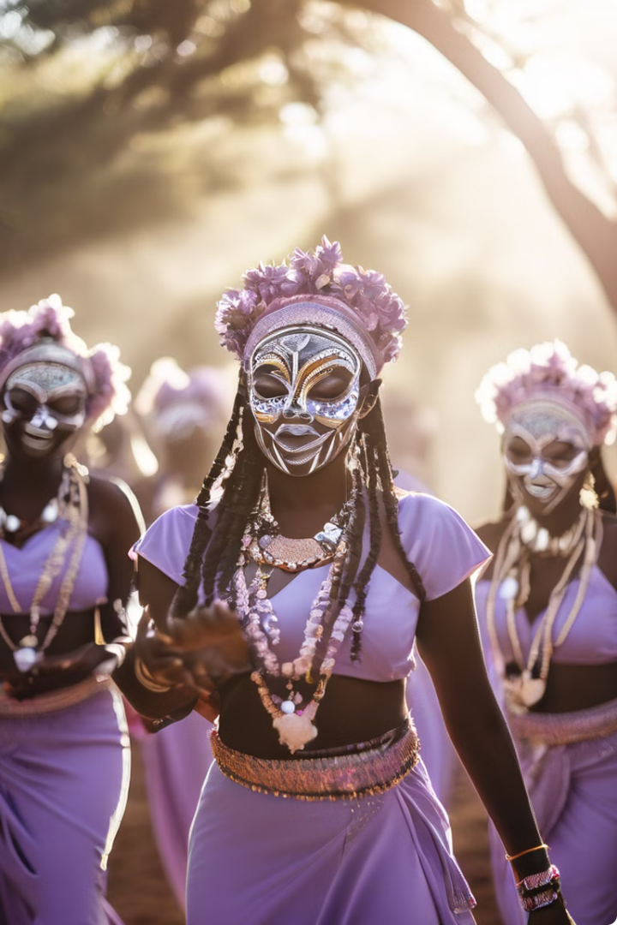
Masks in Rituals and Ceremonies
1
Initiation Rites
Masks often play a central role in initiation ceremonies, marking transitions from childhood to adulthood and signifying the acceptance of social responsibilities.
2
Healing Rituals
Masks associated with specific deities or spirits are used in healing rituals to appease ancestors, ward off evil spirits, or restore health and balance.
3
Festivals and Celebrations
Masks are integral to festivals and celebrations, serving as visual representations of deities, ancestors, or cultural heroes, fostering a sense of community and collective identity.

Slide 4
Artistic Techniques and Materials
Carving
Painting and Decoration
Textiles and Adornments
Masks are often carved from wood, ivory, or other materials, showcasing intricate details and skillful craftsmanship.
Vibrant colors, pigments, and natural materials are used to decorate masks, reflecting the artistry and cultural aesthetics of the region.
Masks are often adorned with feathers, beads, fibers, and other materials, adding texture, symbolism, and a sense of movement to the piece.

Slide 5
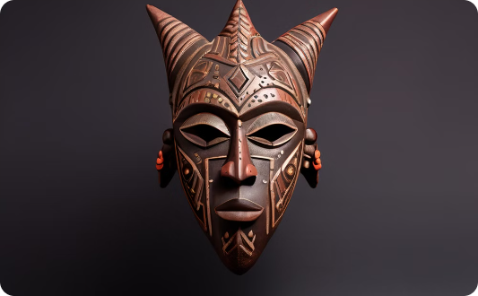
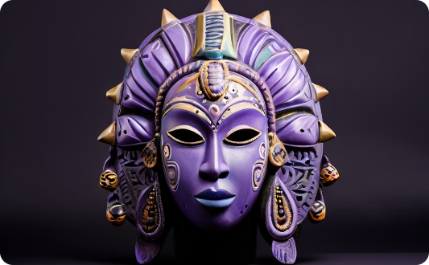
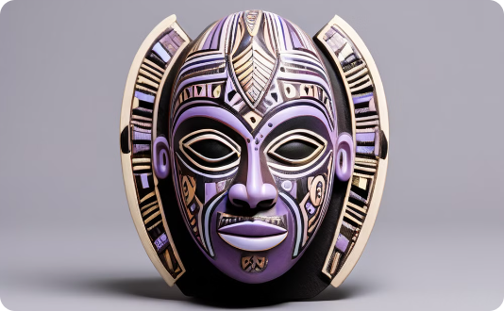
Diversity of Mask Styles
Dogon Masks
Yoruba Masks
Baule Masks
Dogon masks from Mali are known for their geometric designs, elongated features, and symbolic representations of ancestor spirits.
Yoruba masks from Nigeria are often characterized by bold, expressive features, vibrant colors, and elaborate headdresses, representing deities and spirits of the natural world.
Baule masks from Ivory Coast are known for their rectangular shapes, geometric patterns, and powerful presence, representing ancestors, spirits, or deities.

Slide 6




Preserving Mask-Making Traditions
Community Workshops
Museum Collections
Digital Documentation
Workshops and training programs help ensure the continuity of mask-making traditions, passing down skills and knowledge from generation to generation.
Museums and cultural institutions play a crucial role in preserving and showcasing masks as important cultural artifacts.
Digital archives and online platforms help preserve and share knowledge about mask-making techniques and cultural significance.

Slide 7
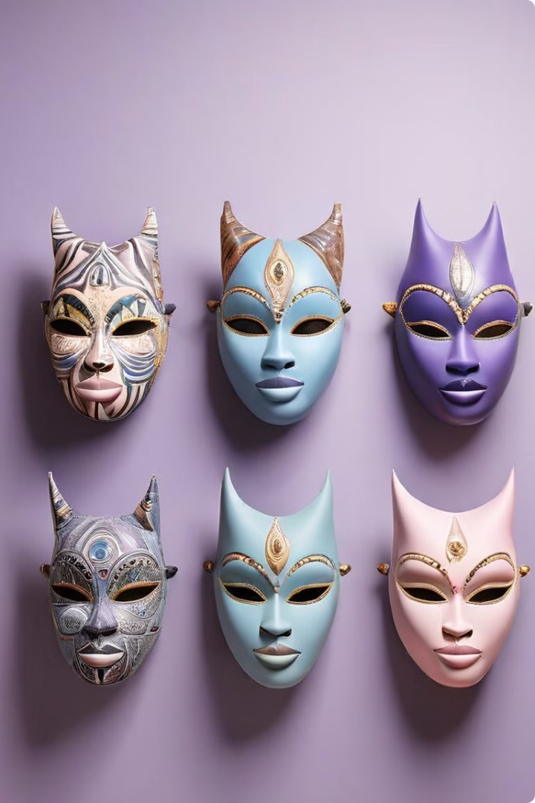
Masks in Contemporary Art and Culture
Contemporary Art
Contemporary artists continue to find inspiration in traditional African mask designs, reinterpreting them in new ways that address contemporary issues and perspectives.
Fashion and Design
Mask motifs and imagery are increasingly incorporated into fashion, graphic design, and other creative fields, demonstrating the enduring impact of African art on global culture.
Cultural Exchange
Masks serve as a powerful tool for promoting cultural exchange, fostering appreciation for diverse traditions, and challenging stereotypical views of Africa.

Slide 8
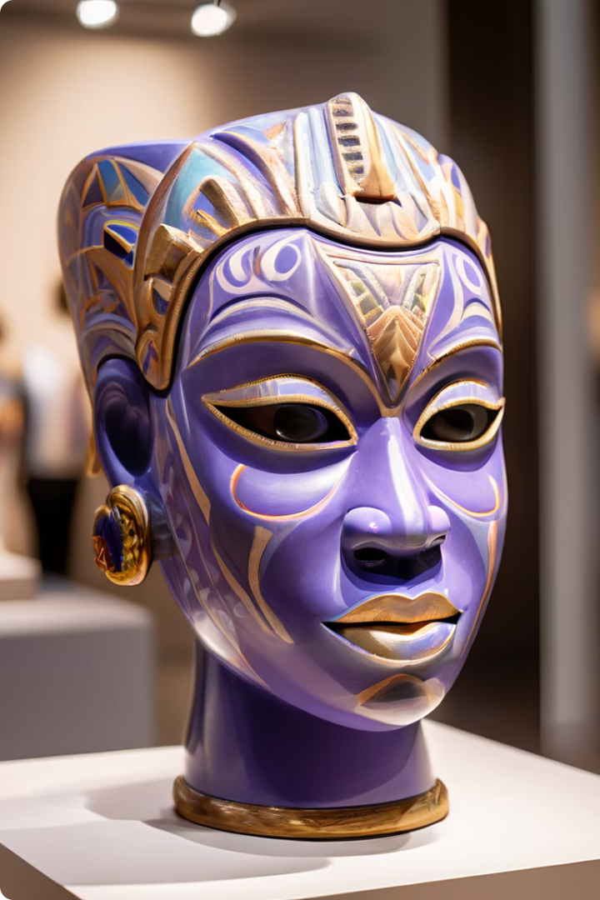
The Enduring Significance of African Masks
African masks are not merely decorative objects; they are living testaments to rich cultural histories, spiritual beliefs, and artistic expressions. They continue to inspire, challenge, and captivate audiences worldwide, reminding us of the enduring power of art and culture to connect us across time and space.

